Slide 1
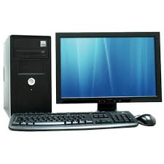
Computer

Slide 2
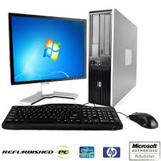
Computer
It is an electronic device that is designed to work with Information.
The term computer is derived from the Latin “Computare” which means “to calculate”.
It cannot do anything without a program.
It represents the decimal numbers through a string of binary digits.

Slide 3
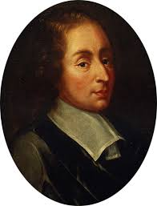
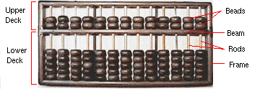
History of Computer
In 1642 Blaise Pascal (a famous French mathematician) invented an adding machine based on mechanical gears in which numbers were represented by the cogs on the wheels.

Slide 4
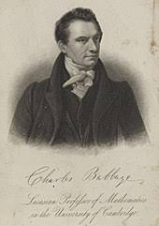
The computer as we know it today had its beginning with a 19th century English mathematics professor name Charles Babbage. He designed the Analytical Engine and it was this design that the basic framework of the computers of today are based on.

Slide 5
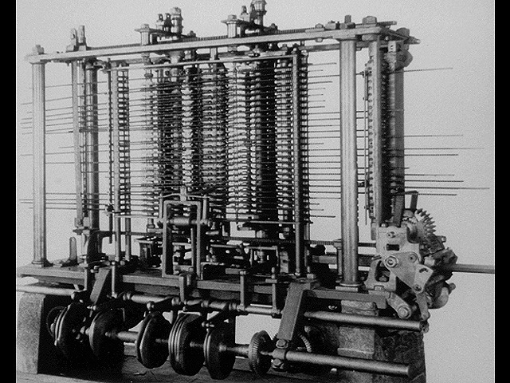
Features of Analytical Engine
Analytical Engine 1833could store numbers
powered by steam
accurate to six decimal places

Slide 6
Evolution of Computer
First Generation (1946-1959) Vacuum tube based
Second generation (1959-1965) Transistor based
Third generation (1965-1971) Integrated Circuit based
Fourth generation (1971-1980) VLSI microprocessor based
Fifth generation (1980-onwards) ULSI microprocessor(Artificial Intelligence) based

Slide 7
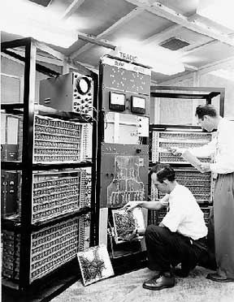
First Generation (1946-1959) Vacuum tube based
Storage Device – Magnetic drum, 1 KB memory
Software – Machine and Assembly language
Application – Scientific and simple business systems

Slide 8
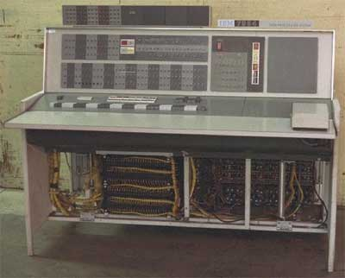
Second generation (1959-1965) Transistor based
Storage Device – Magnetic tapes, disk, 100 KB memory
Software – FORTRAN, COBOL, Batch operating system
Applications – Extensive Business applications, engineering & Scientific research

Slide 9
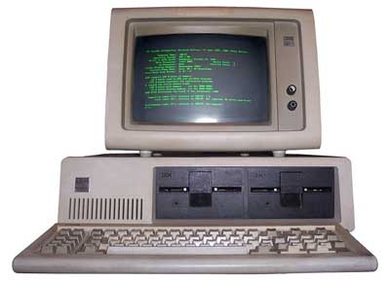
Third generation (1965-1971) Integrated Circuit based
Storage Devices – High speed magnetic cores, large disk, 1 MB memory
Software – FORTRAN-IV,COBOL 68
Applications – on-line system, Database management system

Slide 10
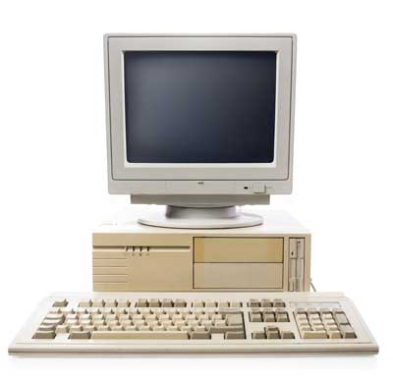
Fourth generation (1971-1980) VLSI microprocessor based
Storage – Semiconductor memory, 1000 MB disks
Software – FORTRAN-77,PASCAL,COBOL 74
Applications – personal computers,graphics oriented system,

Slide 11
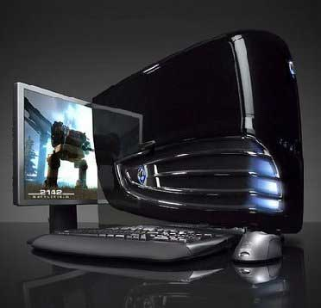
Fifth generation (1980-onwards) ULSI microprocessor(Artificial Intelligence) based
Millions of transistors
64 bit
Used Artificial Intelligence
Software - C and C++, Java, .Net

